Slide 1

I LEARN -maths!

Slide 2

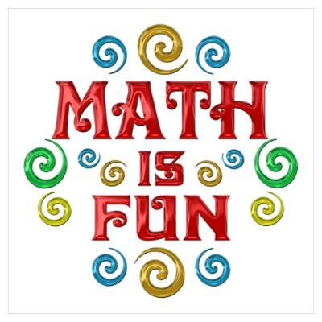
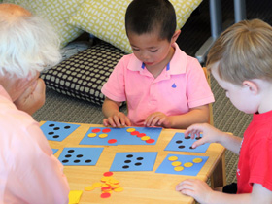
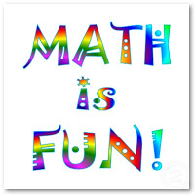
Build strong, positive attitudes about maths!
You can be your child's first role model for learning- Show them maths can be fun!
Help them and support them to enjoy exploring the world of maths.

Slide 3
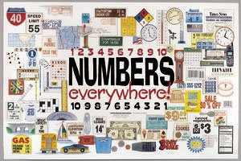

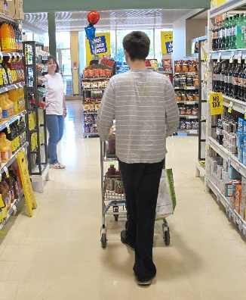
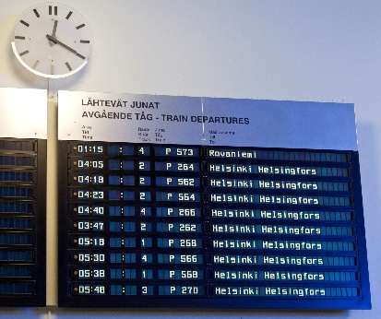
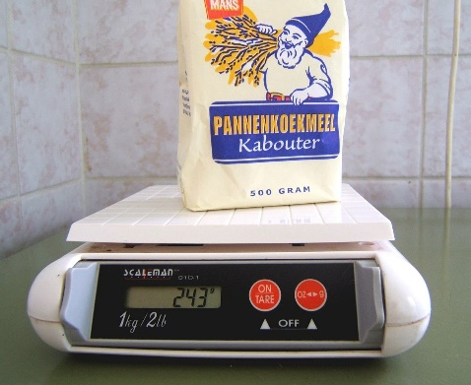
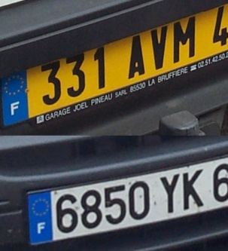
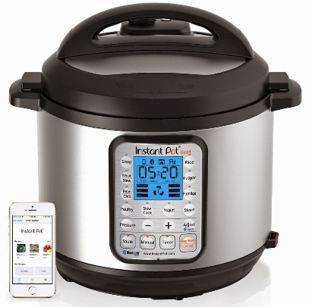

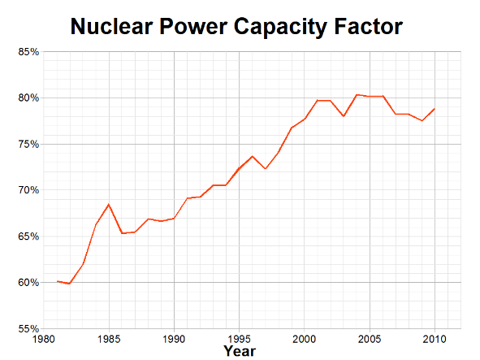
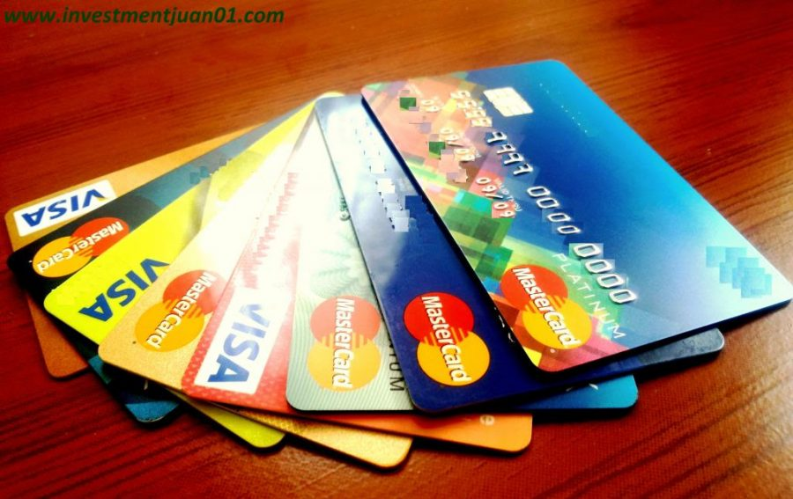
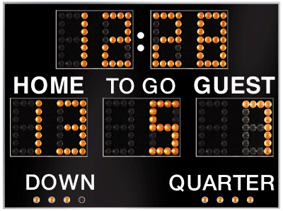
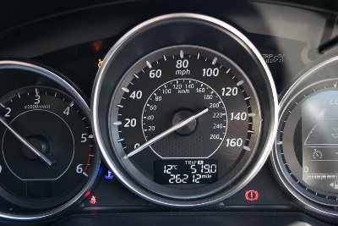
Why is maths important?
Maths and numbers are everywhere!

Slide 5
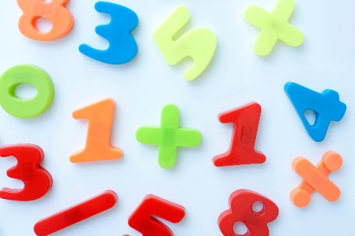
Maths learning in Starfish class
Number | Shape, space and measures
Counting Ordering Recognising numbers Adding Subtraction Doubling Halving sharing | Patterns Shape Size Position Time Money

Slide 6
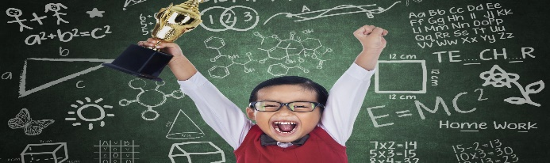
Early learning goals
By the end of Reception children should be able to….
Have an understanding of number to 10, linking names of numbers, numerals, their value, and their position in the counting order;
Subitise (recognise quantities without counting) up to 5;
Automatically recall number bonds for numbers 0-5 and for 10, including corresponding partitioning facts.
Automatically recall double facts up to 5+5;
Compare sets of objects up to 10 in different contexts, considering size and difference;
Explore patterns of numbers within numbers up to 10, including evens and odds.

Slide 7

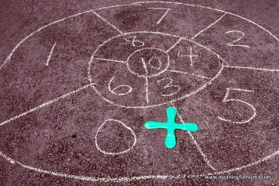
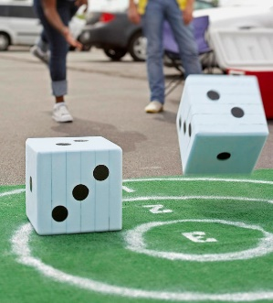
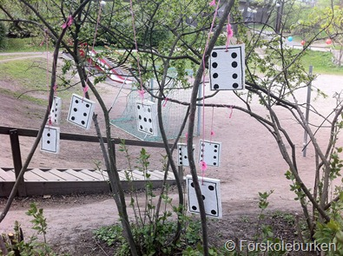
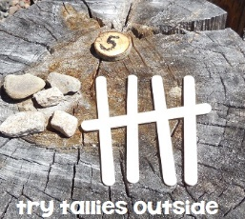
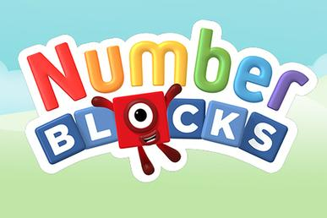
How do we teach maths in the Starfish class?
Whole class lessons, including chanting and using images to show different numbers.
Play/art/outdoor activities involving number
Interactive whiteboard games (purple mash)
Investigations
Stories and songs involving numbers.

Slide 8
Good counting from the start !
Children can make mistakes if they don’t include every object when they are counting.
Practise this by giving your child groups of things to count.
Check that they include every object when they count.

Slide 9
Teaching counting
Children will practise counting in class in lots of different ways.
Children count forwards from zero or will start from different numbers.
Children will count backwards from different numbers too.
The teacher might use a counting stick or number line to help children count.
Children can point to different numbers and talk about what comes before or after.

Slide 10
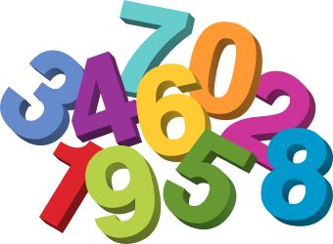

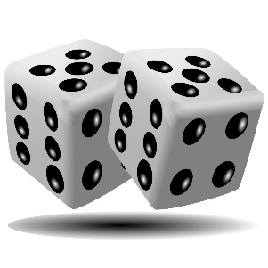
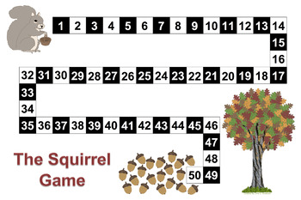
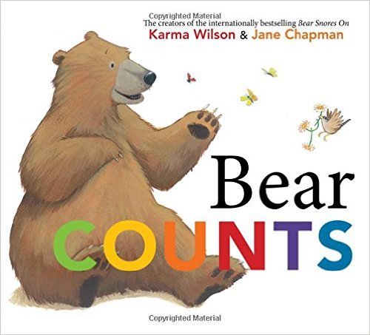
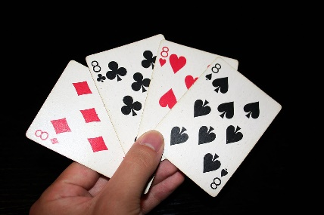
Counting
When children learn to count they like to touch, point to and move objects as they say the number aloud.
Helping at home-
Count forwards and backwards
Nursery rhyme and stories
Counting indoors and outdoors
Maths games with cards and dice

Slide 11
Writing numbers
Make the link between the objects and the number by showing the correct amount.
Numbers are difficult to write!
Practise number formation by using dotted guides or holding your child’s hand as they write.

Slide 12
Ordering numbers
Ordinal numbers like first, second and third tell us the position of something.
Use everyday tasks, toys and games to help your child understand order.
Talk about order when getting ready for school. You might eat your breakfast first and brush your teeth second.
Talk about order when your child is playing. Were they first in the race or second in the game?

Slide 13

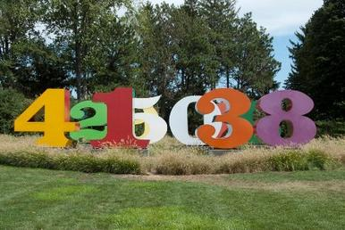
Making sense of numbers
As children get more confident with oral counting, they learn to connect quantities( such as 5 buttons) with their number names (the word 5) and then the symbol (5).
Helping at home-
*Look for numbers at home or when out and about
*play I Spy something in the room that there are 3 of
*encourage them to record “ how many” in pictures and numbers

Slide 14


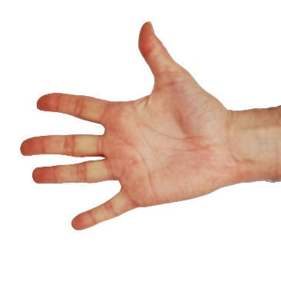


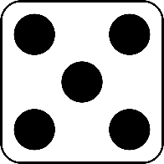
Understanding and representing numbers
Counting out loud to 10 does not mean they can fully understand the number!
There is a lot to it!

Slide 15


Problem solving
Try to involve your child in using numbers to solve problems and make everyday decisions e.g.
“ We need 6 tomatoes and only have 2 . How many more do we need?”
“You have 3 sweets and I have 4- how many altogether?”
“ We have 4 cakes to share between the 2 of us. How many each?”
Encourage them to talk about an show a maths problem that makes sense to them-they could draw it, act it out, use real objects or fingers

Slide 16
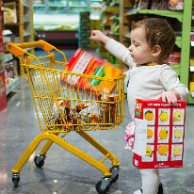
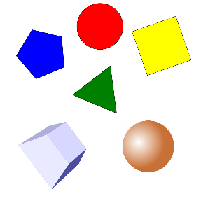
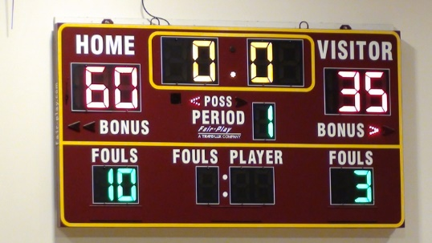
Maths out and about
Go on a shape hunt.
Look for and make patterns
Play games involving counting- hipscotch,hide and seek,whats the time Mrs Wolf,skipping,hula hooping
Play sport! Keep the score- who has more/less goals, point etc
Look for numbers around- cars,doors,buses,shops
Count anything- doors,lampposts,dogs,cats,birds
Talk about time

Slide 17
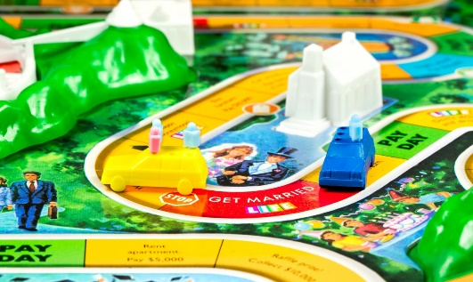
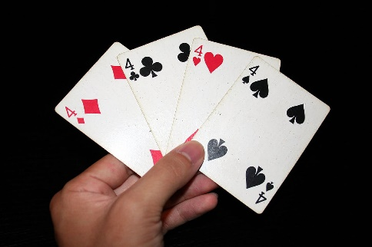
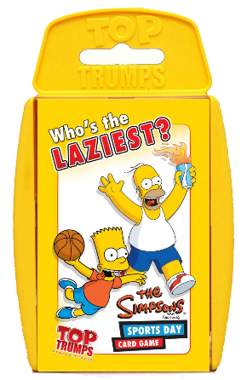
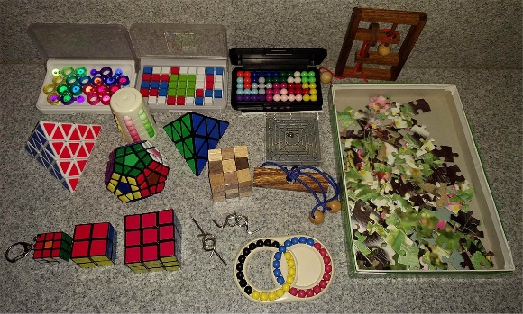
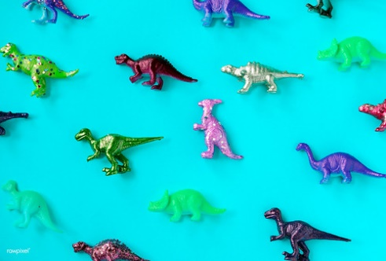
Maths and games
Board games- snakes and ladders,ludo,monopoply
Card games- snap, memory pairs,Uno,top trumps
Other games- connect 4,Jenga
Jigsaw puzzles
Construction- Lego,K-Nex,Meccano,sticklebricks
Toy figures- animals,dolls,bears,action figures, dinosaurs

Slide 19

Useful websites
https://www.ictgames.com/mobilePage/
http://www.crickweb.co.uk/
https://www.bbc.co.uk/cbeebies/topics/numeracy
https://www.sesamestreet.org/toolkits/math
https://nrich.maths.org/early-years

