Slide 1
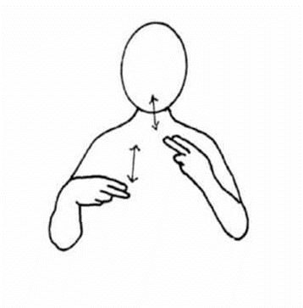
 | Week 1
 | Red | Green | Dinner
Dinner

