Slide 1
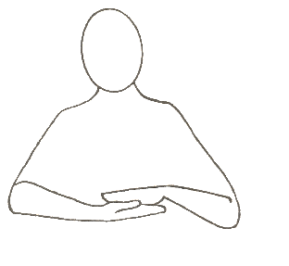
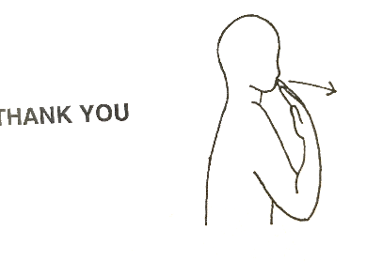
 | Week 2
 | Sandwiches | Please | Thank you
Sandwiches
Please
Thank You

