Slide 1
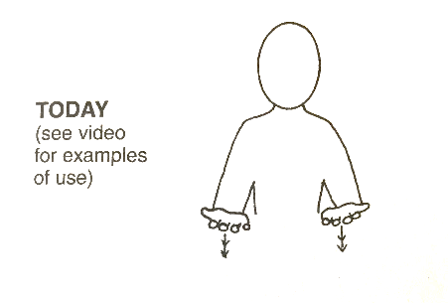
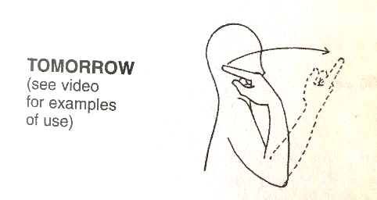
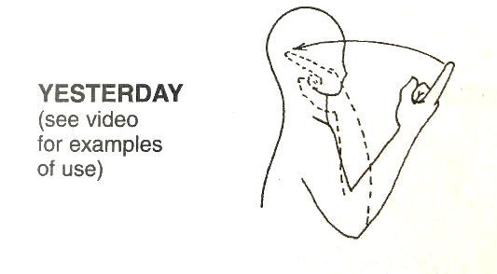
 | Week 8
 | Today | Tomorrow | Yesterday
Today
Tomorrow
Yesterday

